Slide 1

GetTourism
Prepared by:
Sarah Aljurbua
Rahaf Daas
Sara Alojayan
Hafsa Al Siddiky
Noor Mohamad
Section: 1188
Supervised by:
Dr. Sofianiza Abd Malik
Dammam
Riyadh

Slide 2

Prototype logo

Slide 3

OUTLINE OF THE SLIDES
Summarized timeline of all project milestones
Methods and materials used in the project milestones
Link to the high-fidelity prototype
Conclusion
References

Slide 4
Timeline of PMs
01
PM1
PM2
PM3
Prototype
Choosing group members
Topic brainstorming
Documentations (Google Documents)
Gathering of requirements and needed functionalities (methods mentioned next)
Deciding target audience/user profile
Gathering feedback and evaluations
Working on the high-fidelity prototype using Protopie.io

Slide 5
02
Methods used
Interviews (face-to-face and Google meets)
Surveys (via google forms)
Recordings
2.1
Obtained permission from interviewees using a consent form

Slide 6
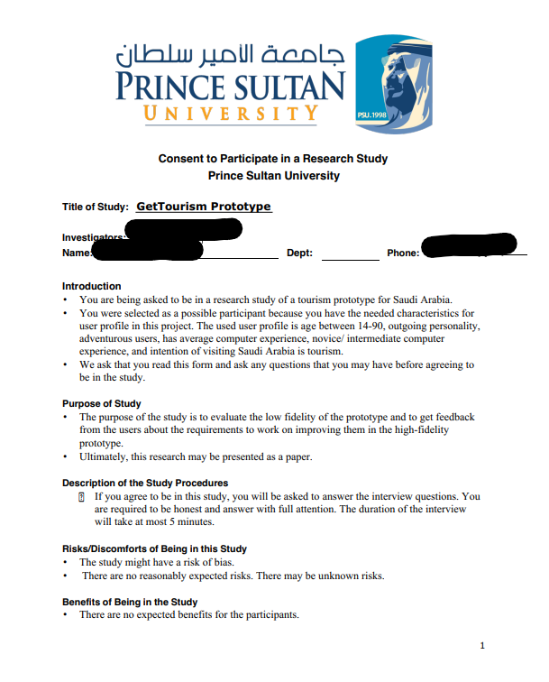
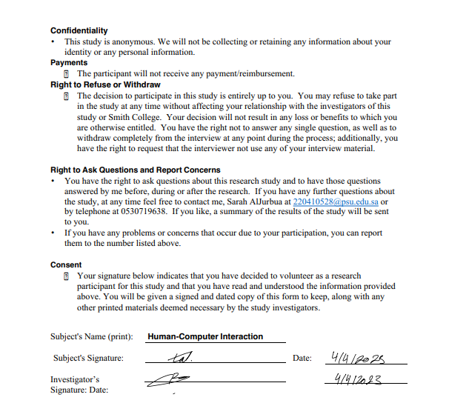
Consent form

Slide 7
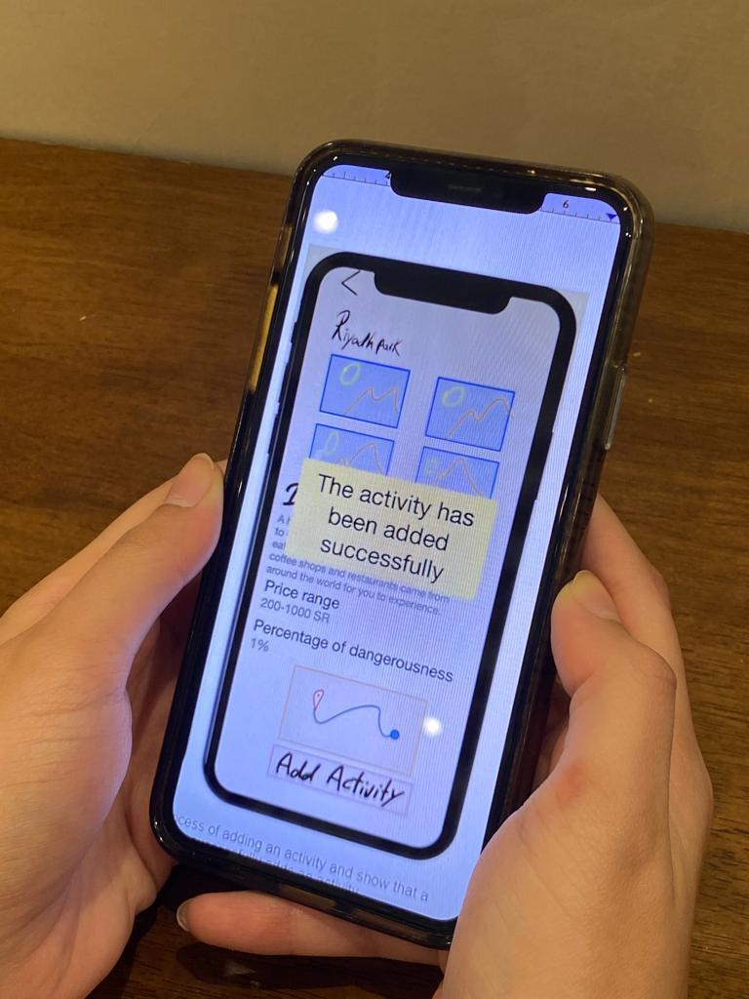
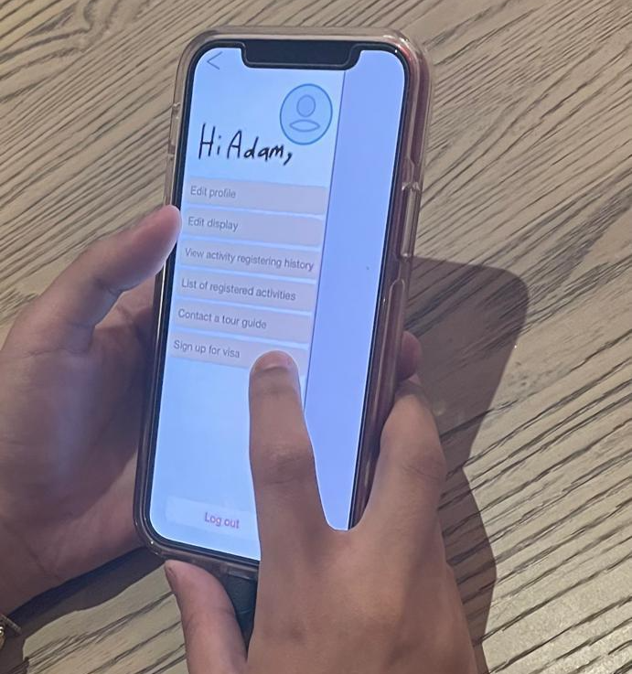
Pictures of the Participants Using the Low-Fidelity Prototype

Slide 8
03
Link to high-fidelity prototype
https://cloud.protopie.io/p/21dd6abb9c108b7bb9f6d5ff

Slide 9
Conclusion & References
04
Initial research and ideation
Creation of low-fidelity prototypes
User testing and feedback
Refinement of design through multiple iterations
Development of high-fidelity prototype
Anonymous, GoodNotes, Best Note-Taking App for iPad. (n.d.). https://www.goodnotes.com/
ProtoPie. (n.d.). ProtoPie | High-Fidelity Prototyping for Mobile, Desktop, Web & IoT. https://www.protopie.io/

